Slide 1
Global Business, Emerging Markets and Human Rights: Old Concerns or Fresh Hopes?
MsM 4th Annual Research Conference
5 September 2014, Maastricht

Slide 2
Это наш бизнес-партнер
Двудипломная программа Joint MBA MSM (Нидерланды)
Совместная программа Международной Академии Бизнеса и Маастрихтской Школы Менеджмента (Нидерланды)
Специализация: «Общий и Стратегический Менеджмент»
Программа Joint MBА дает интеграцию в международную среду путем обучения в одной из старейших бизнес-школ Европы (выездной модуль в Маастрихтскую Школу менеджмента), способствует получению престижного образования без продолжительного отрыва от производства и признанного диплома международного образца….

Slide 3
About the organizers
Maastricht School of Management (MSM) is a 60-year old international business school located in the Netherlands, offering MBA, EMBA and Doctoral education throughout the world in partnership with educational institutions primarily in developing and emerging economies.
In 2014 it becomes part of the Maastricht University.

Slide 4
About the organizers
The School of Business and Economics at Maastricht University offers education programs for bachelors and master’s students, PhD candidates and professionals (MBA, executive masters). It is one of only 1% of business faculty’s worldwide to be triple-crown accredited (EQUIS, AACSB and AMBA).

Slide 5
About the organizers
The Faculty of Law at Maastricht Univer-sity has approximately 2,500 students and 250 staff members. Comparative law, international and European law and the relationship with national law and human rights are the most important fields of research

Slide 6
Conference Program
PLENARY SESSION I (Function Hall)
09:00 – 09:15 Opening and welcome by Prof. Wim Naude (Dean, Maastricht School of Management) and Prof. Hildegard Schneider (Dean, Faculty of Law, Maastricht University)
09:15 – 10:00 Keynote address:
“New Trends in Innovation and Knowledge Society”
Presenter: Prof. Jurgen Ruttgers, former Minister-President of North Rhine-Westphalia, Germany

Slide 7
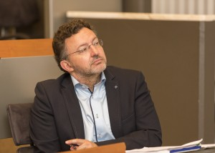
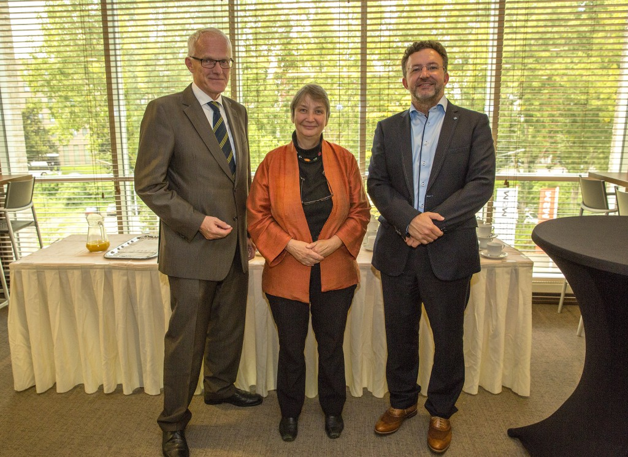
Идея конференции
Since the worldwide economic crisis, now that some of the stronger emerging markets and developing countries are now witnessing fresh economic recovery, will we see real progress in human rights?

Slide 8
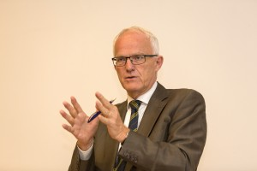
Основной докладчик - Prof. Jürgen Rüttgers, former Minister-President of North Rhine-Westphalia
The pace of change in the knowledge society has speeded-up to an alarming degree but this has not necessarily led to improved corporate governance.
Prof. saw that failed states could not be salvaged if there was no dialogue between the common people and the elites.

Slide 9
Организатор
On a less hopeful note, he thought that on the other hand we might see a continuing erosion and sell-out of the principles of human rights. Are human rights and the end of poverty still seen as luxuries of Western countries – but now they can’t afford them, especially as now they are no longer such big players on the world stage?
Prof. Wim A. Naude, PhD
Dean Director, Professor of Development Economics and Entrepreneurship
Maastricht School of Management

Slide 10
The Dean and key members of the DBA-team at the Maastricht School of Management, 2013

Slide 11
Parallel Session I (Room 223)
Chair: Harald Sander (MSM)
“Food security in Kazakhstan within the integration into the Eurasian Economic Union: Ratings and ways to reduce threats”, Bayanslu Markhayeva
“International frameworks and initiatives for business conduct in fragile and conflict states "The role of Institutions and culture for fragile firms in Bosnia-Herzegovina", Laura Gianfagna and Emi Ferra
“ TBA” Stephanie Jones

Slide 12
Parallel Session VI (Room 225)
Chair: Stephanie Jones (MSM)
“The case of the "Big Data" revolution”, Jan Worst
“The role of participatory management in fostering job satisfaction among public administration employees”, Marjan Bojadziev and Miodraga Stefanovska

Slide 13
Докладчики
The conference wrapped-up with controversial discussions on who owned “big data” and what possibility we might have to control it (MSM’s Dr Jan Worst);
on co-operation of Tunisia with the EU since the Arab Spring (Dr Juliane Brach, from Denmark); and developmental challenges in Georgia, recovering from battles with Russia (Dr Lela Jamagidze and Dr Nina Papachashvili from Tbilisi).

Slide 14
Докладчики
Participants enjoyed discussing the state of public administration and its employees in Macedonia, facing rising unemployment, as it seeks to gain accession to the European Union (presented by Dr Maryan Bojadziev, the Provost of the University American College in Skopje, working in close collaboration with MSM’s outreach network).

Slide 15
Parallel Session IV (Room 225)
Chair: Juliane Brach (MSM)
“Social Media and Human Rights - reflections on China, Iran and Turkey”, Stephanie Jones
“The Business of Genocide - Understanding the how and why of corporate complicity in genocides”, Nora Stel
“Import of Institutions and Economic Value Trans-formation: The Interactions among the Economic Agents in Georgia”, Lela Jamagidze and Nino Papachashvil

Slide 16
The city of Maastricht
Maastricht is located in the most southern part of the
Netherlands, approximately 220 km from Amsterdam
(Schiphol) Airport and 120 km from Brussels Airport (Belgium).
Maastricht is the capital of the province of Limburg. A small city with just under 120,000 inhabitants, the city is situated on both sides of the river Maas in the south-eastern corner of the Netherlands, practically bordering Belgium and Germany.

Slide 17
Маастрихтский договор (The Treaty of Maastricht)
Подписан 7 февраля 1992 г.
Это документ, положивший начало Европейскому союзу (European Union).
Был призван содействовать превращению Европейского сообщества (European Community) в политический, а затем – в экономический и валютный союз.
В Маастрихтский договор помимо разделов об экономическом сотрудничестве были включены разделы о внешней политике и правосудии, что означало формирование трех опор ЕС:
– экономический и валютный союз; – общая внешняя политика и политика безопасности ЕС; – сотрудничество государств-членов в области внутренних дел и правосудия.

Slide 18
Food security in Kazakhstan within the integration into the Eurasian Economic Union: Ratings and ways to reduce threats
Bayanslu Markhayeva
Almaty Management University
Kazakhstan

Slide 19
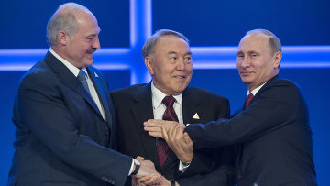
Structural evolution of the EaEU (EEU)
 |  |  |  | Eurasian Economic Union (EEU) (signed 29 May 2014) (established 1 Jan 2015)
 |  |  | Eurasian Economic Space (1 Jan 2012)
 |  | Eurasian Customs Union (1Jan 2010)
 | Eurasian Economic Community (10 Oct 2000)
Increased Integration in the Economic and Humanitarian Fields
Original proposal (1994)
Commonwealth of Independent States (8 Dec 1991)

Slide 20
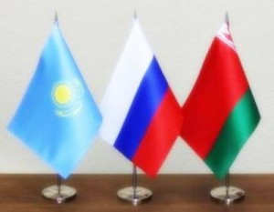
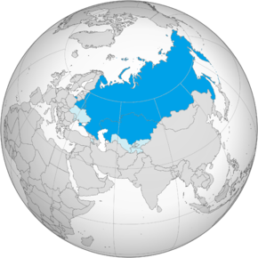
The Eurasian Economic Union: Fresh Hopes or Old Concerns?
Territory Population GDP
1st place 8th place 6th place
20,2 mln kм² 172,6 mln 2,895 trln USD

